Slide 1
Experimentele basistechnieken – mei 2025 – Atom probe Tomography

Slide 2
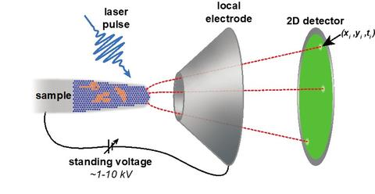
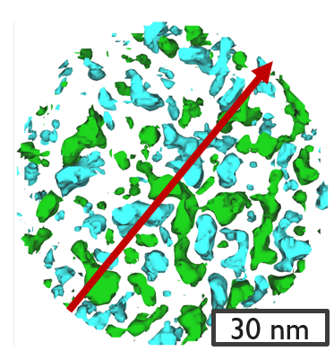
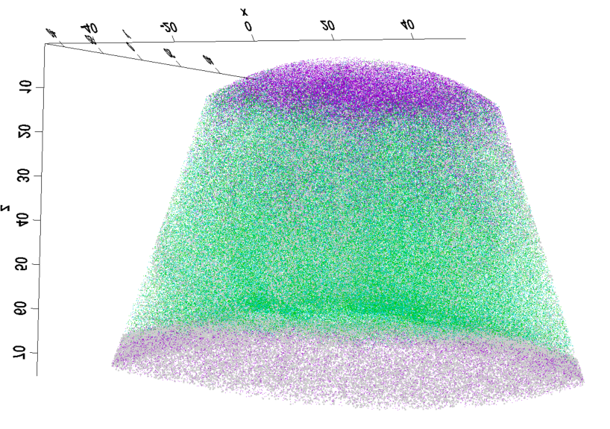
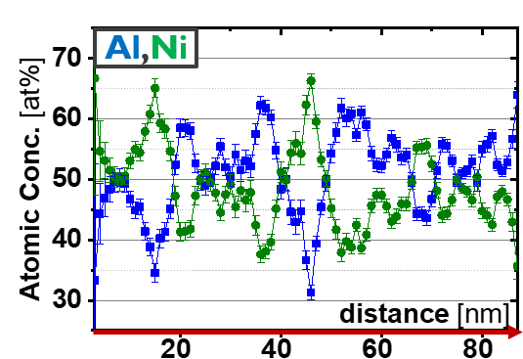
Atom probe tomography
! Accurate reconstruction (“place atoms back”): need information on ion trajectories!
[1]
Reconstruction
[2]
Al
Ni
Si
O
TOF element
identification
40 nm
APT tip specimen
x
y
Field of View
z
+
Field evaporation
(F~10 V/nm)
Atom Probe Tomography: materials characterization based on field evaporation from needle specimen (ø~100nm)
Three-dimensional reconstruction of atomic positions > 3D nanoscale compositional analysis
[1] https://www.nist.gov/programs-projects/extreme-atom-probe-tomography
[2] C. Adelmann et al., "Intermetallic Compounds as Alternatives to Copper for Advanced Interconnect Metallization," , doi: 10.1109/IITC/MAM57687.2023.10154839

Slide 3
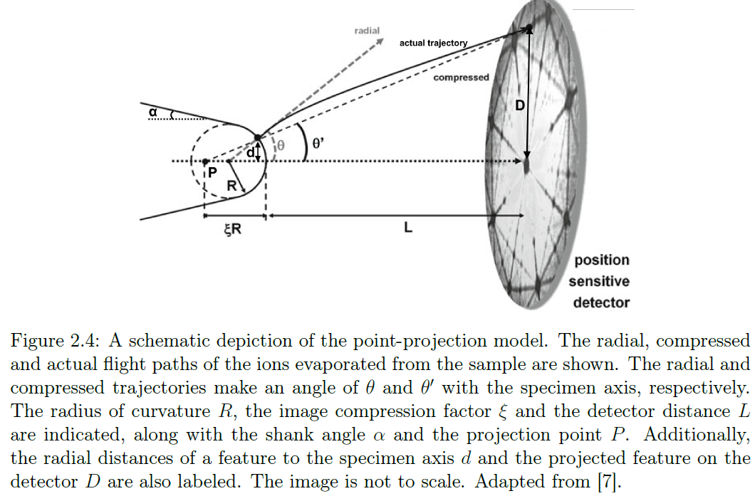
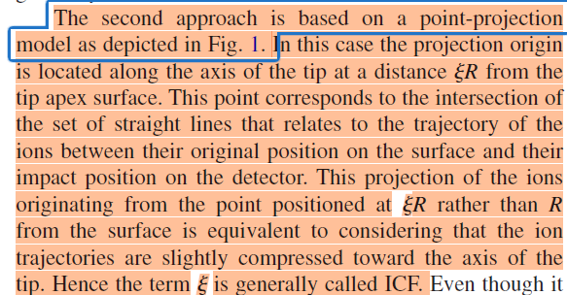
Reconstruction: point-projection model
(observed)
[Gault2009]
[Baron2022]

Slide 4
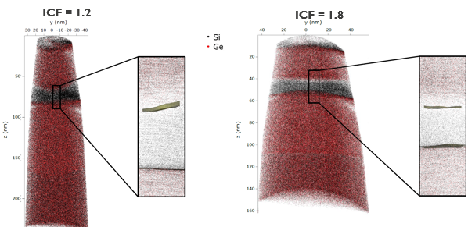
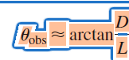
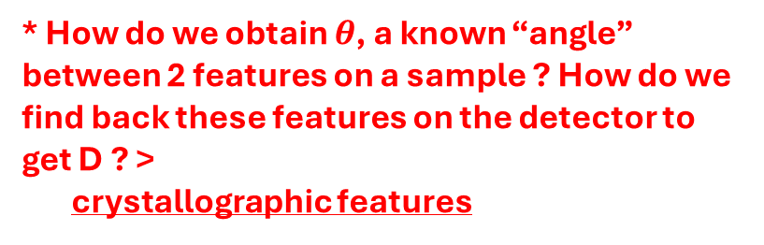
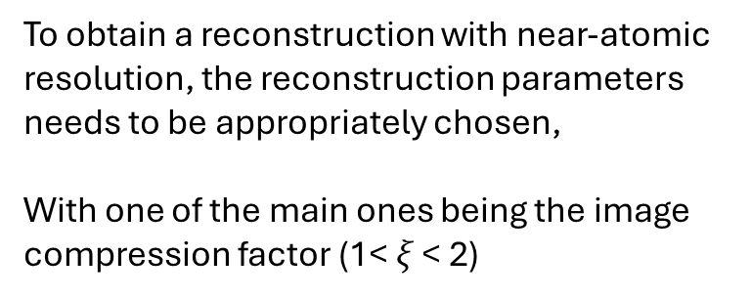
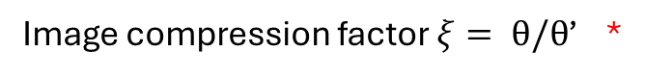
Reconstruction: Image compression factor
[Baron2022]
A
A
B
B
A
A
(observed)
(observed)
To obtain a reconstruction with near-atomic resolution, the reconstruction parameters needs to be appropriately chosen,
With one of the main ones being the image compression factor (1< $ξ$ < 2)
Image compression factor $ξ= θ/θ$’ *
Distance 2 features on detector? *
* How do we obtain $θ$, a known “angle” between 2 features on a sample ? How do we find back these features on the detector to get D ? >
crystallographic features

Slide 5
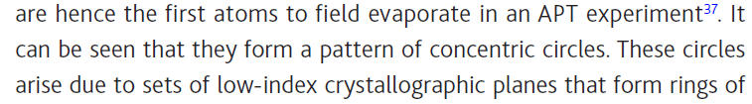
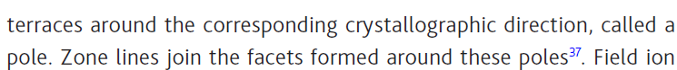
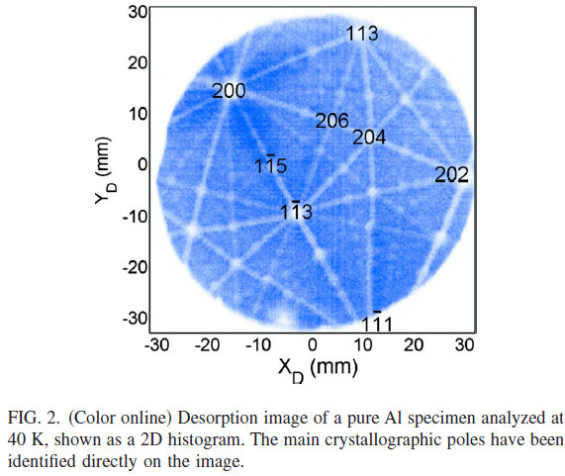
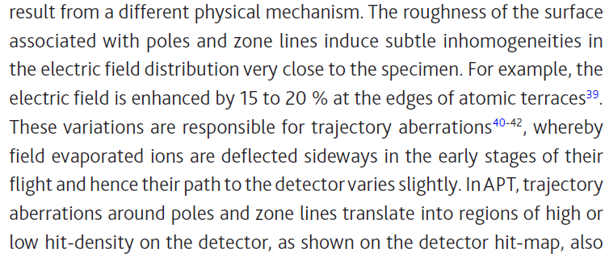
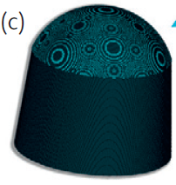
Crystallographic features in APT data
An APT specimen is not a mathematical smooth surface. For crystalline samples, the surface of the tip is actually conceived of atomic terraces, looking like concentric rings around so-called (low-index) poles. Sublte inhomogeneities in electric field en field evaporation, make that these appear on the hitmap, typically (but not exclusively) as density variations.
[Gault2012]
[Gault2009]

Slide 6
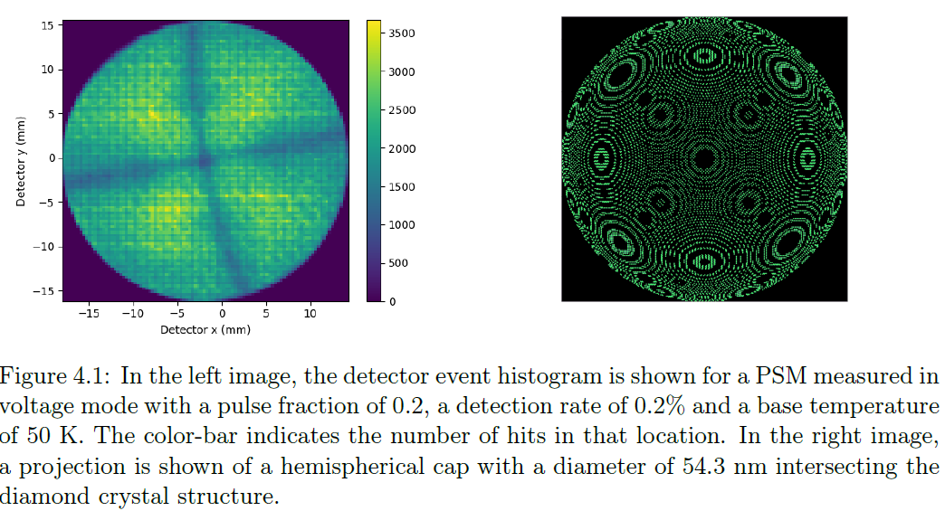
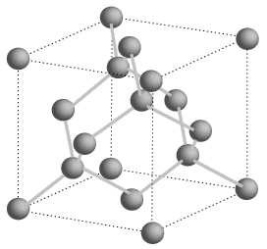
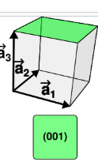
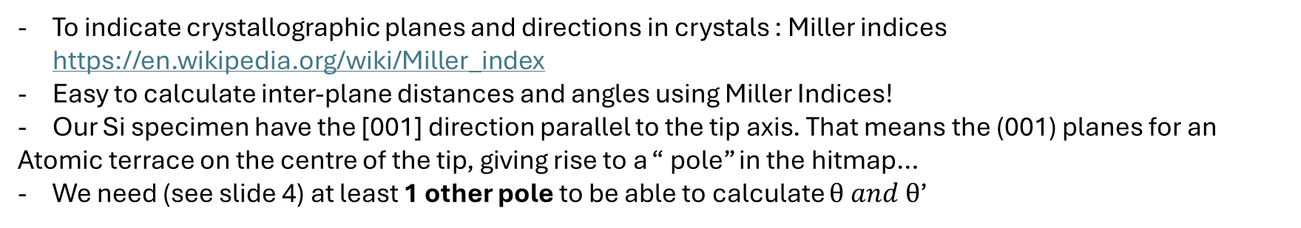
Crystallography (Silicon)
(001)
(001)
[001]
0.543 nm
[Baron2022]
To indicate crystallographic planes and directions in crystals : Miller indices https://en.wikipedia.org/wiki/Miller_index
Easy to calculate inter-plane distances and angles using Miller Indices!
Our Si specimen have the [001] direction parallel to the tip axis. That means the (001) planes for an
Atomic terrace on the centre of the tip, giving rise to a “ pole” in the hitmap…
We need (see slide 4) at least 1 other pole to be able to calculate $θ and θ$’

Slide 7
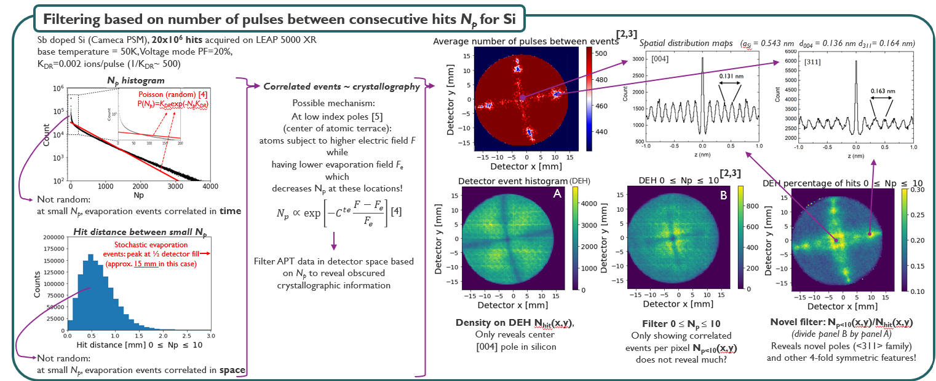
Revealing poles in Silicon
For Semiconductors like Silicon, “pole patterns” are not as nice as for most metals. This is because for a metal, electric field does not penetrate the material (only the outer atoms feel field), while for semiconductor, there is some field penetration… this distorts the evaporation order, etc….
However, we an rely on more “ physics” of the field evaporation to “ reveal” poles…. > Python script available to you!

Slide 8
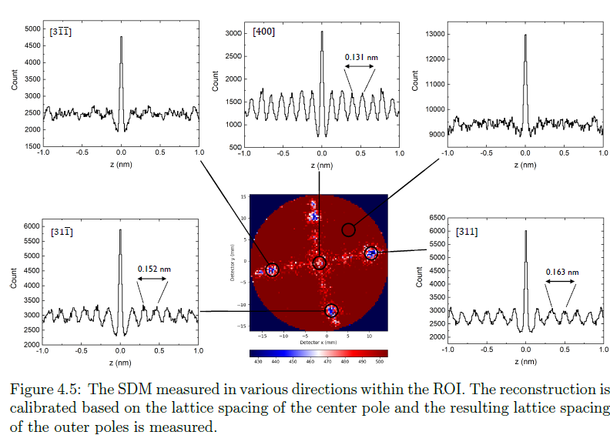
Revealing poles in Silicon
For Semiconductors like Silicon, “pole patterns” are not as nice as for most metals. This is because for a metal, electric field does not penetrate the material (only the outer atoms feel field), while for semiconductor, there is some field penetration… this distorts the evaporation order, etc….
However, we an rely on more “ physics” of the field evaporation to “ reveal” poles…. > Python script available to you!
[001]
!
0.543 nm

Slide 9
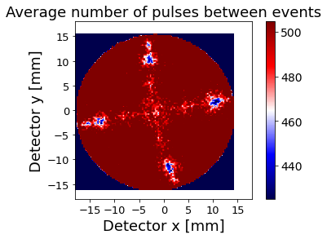
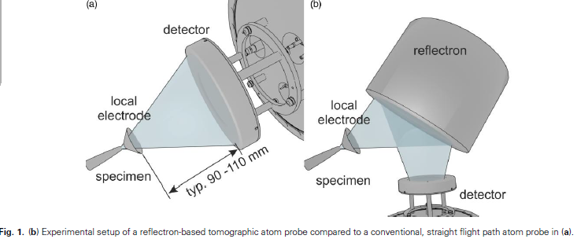
Done?
[311]
[004]
(observed)
No! we have a LEAP 5000 XR > reflectron! ! Basically ,we can’t use a simple triangle to obtain
Heller2024

Slide 10
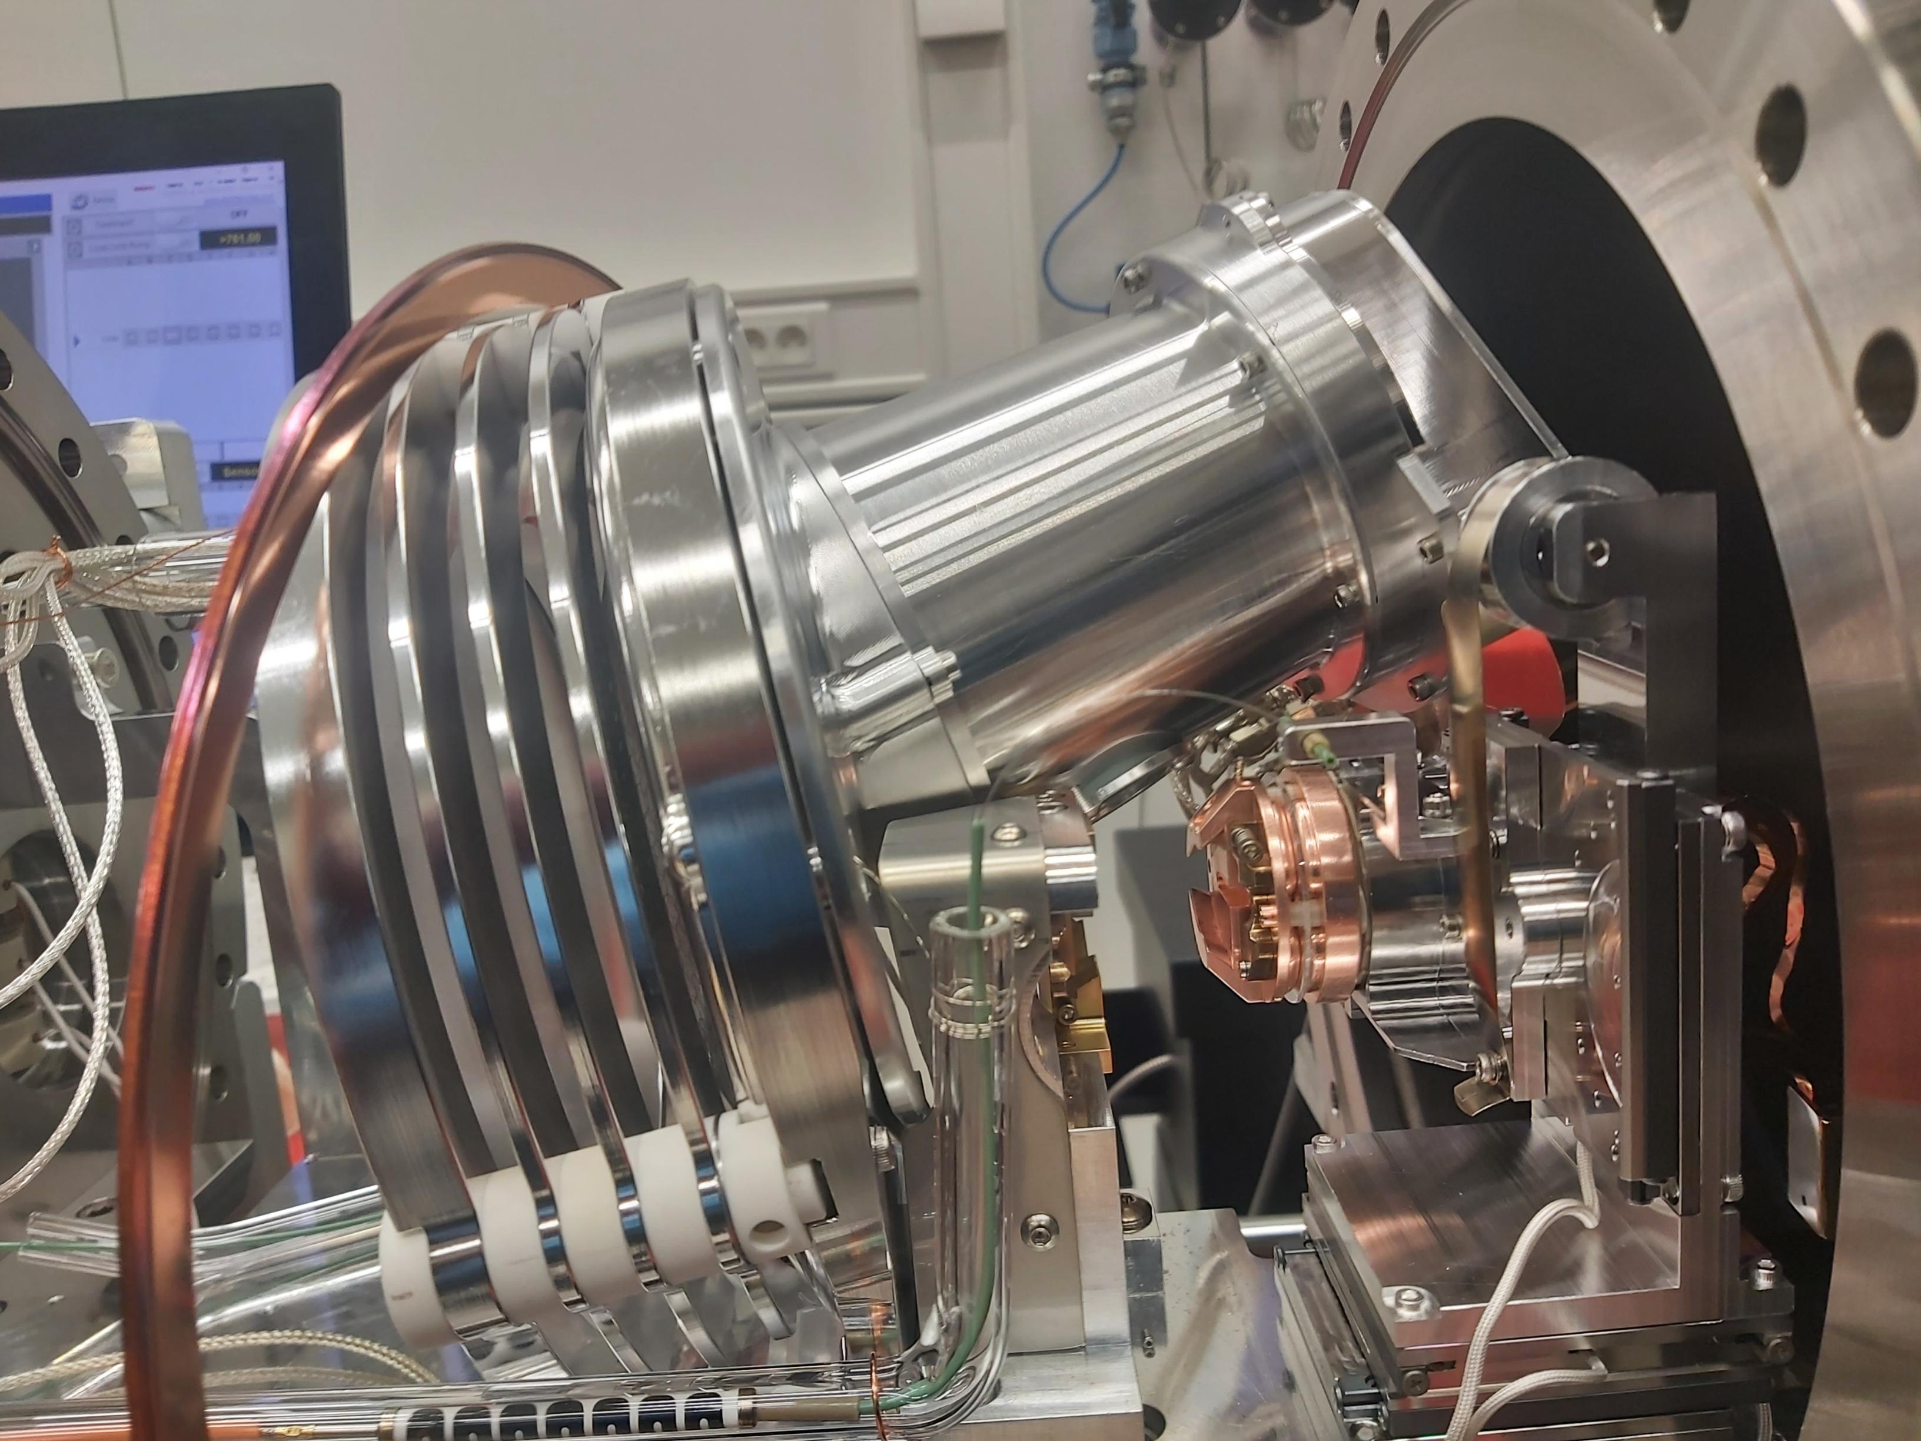
Detector
Reflectron
Sample
ELectrode

Slide 11
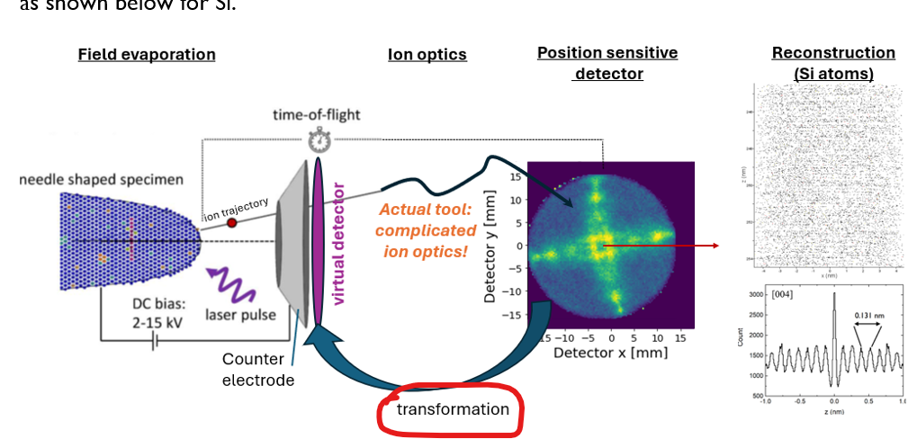
How to solve?
[Heller2024] Martina Heller, Benedict Ott, Peter Felfer, Compensating Image Distortions in a Commercial Reflectron-Type Atom Probe, https://doi.org/10.1093/mam/ozae052
- We can transform our data to obtain a hitmap at a “ virtual” detector location, right at the back of the local electrodes. The specimen – electrode- virtual detector resembles a straight-flight path situation, which means we can use the simple formula’s to calculate the ICF …. -> matlab code available from authors of this paper!

Slide 12
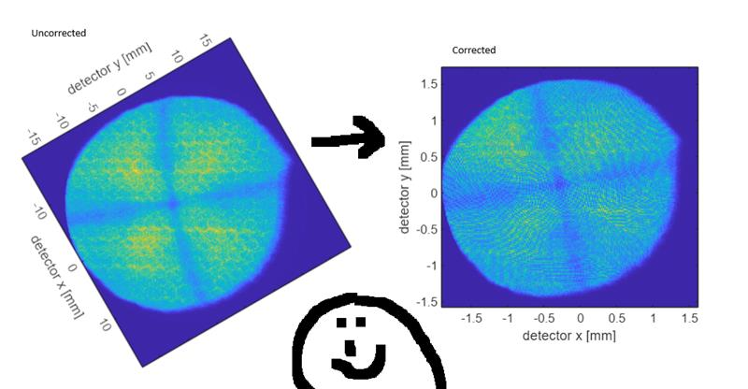
How to solve?
EXAMPLE:

Slide 13
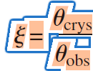
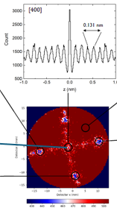
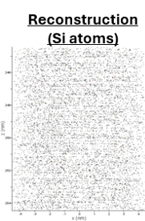
PROJECT PART ONE: - obj: Calculate ICF using 004 and 311 poles from <100> Si in reflectron system using Determine Error on ICF (error on D? we can take multiple poles for the calculation… average? Spread? error on L? )
1. transform experimental “hitmap” of R5069_03581 to “virtual” detector we can use the “calibration” file from the same tool, at Leoben and Oxford to check for variability.
use code from [Heller2024]
2. Reveal the 004 and 311 poles on virtual detector hitmap.
(the result from step 1 is and .epos file, which first needs to be transformed into a .dat file, I can help).
3. Calculate the theoretical angles between 004 and 311 poles, as well as 2x 311 poles?
4. Estimate the flight path L (and error) to the virtual detector (see paper Martina Heller and Lab session)
5. Obtain distance D between poles on virtual detector (many options possible). 6. calculate ICF
7. Compare to Result Yngwie Baron, who optimized the lattice spacing in the reconstruction to match the expected one, and obtained ICF = 1.83…

Slide 14
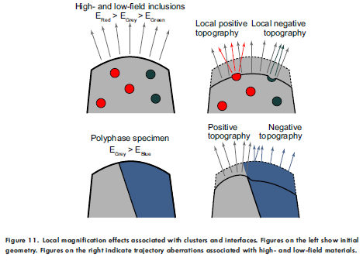
CONTEXT: - While the calibration of the reconstruction parameters (ICF) is important always, our special interest in this topic is somewhat different
- For many, actually interesting samples, the point projection model can no longer be used. When there are multiple materials (so not just a “ bulk” crystal), the ion trajectories can be quite complicated.

Slide 15
CONTEXT: - One way forward is to simulate the ion trajectories, and use these simulated trajectories to reconstruct your actual data… > work of PhD student Julian Luken. - implementing all the internal ion optics (reflectron) in such a simulation is very complicated, and also means that for every different APT tool, you have to implement a new set of ion optics.
however, if we can use the concept of the virtual detector, then the simulator only needs to incorporate the rather simple system of the specimen and local electrode only. (you simulate the virtual detector).
Based on your work, of generating the virtual detector and revealing the poles, …. PhD student Julian can now try to match a simulation of a Si specimen to your results, so prove that this idea is working! Then the simulator is ready for more complicated systems!

Slide 16
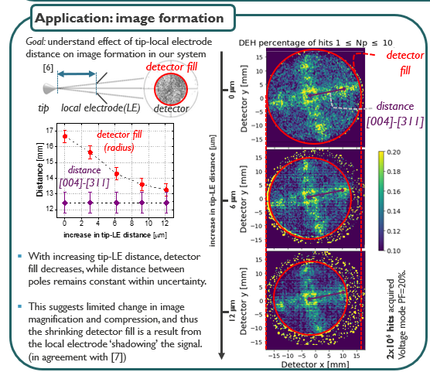
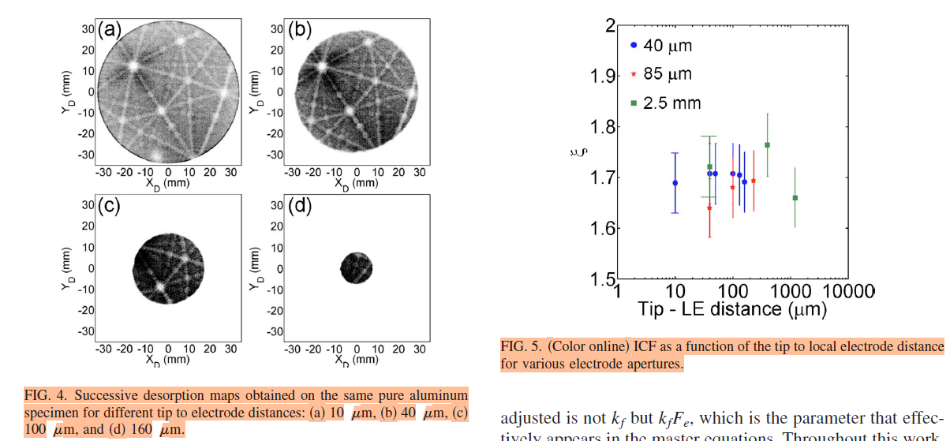
PROJECT PART TWO (TBD): > Calculate ICF (according to part 1) for a set of experiments where the distance between the tip and electrode was varied. Does ICF change or remain constant within error?
[Gault 2009] This can be compared to literature, where this was done on a straight flight path system…

Slide 17
References: [Gault2009] B. Gault et al., Advances in the calibration of atom probe tomographic reconstruction, J. Appl. Phys. 105, 034913 (2009); https://doi.org/10.1063/1.3068197 [Gault2012] Baptiste Gault, Michael P. Moody, Julie M. Cairney, Simon P. Ringer, Atom probe crystallography, Materials Today 15, 378 (2012) https://doi.org/10.1016/S1369-7021(12)70164-5
[Heller2024] Martina Heller, Benedict Ott, Peter Felfer, Compensating Image Distortions in a Commercial Reflectron-Type Atom Probe, https://doi.org/10.1093/mam/ozae052
[Baron2022] Yngwie Baron, internship report Interface characterisation in SiGe/Si/SiGe multilayers using atom probe tomography (2022)
[Scheerder2023] Jeroen E. Scheerder et al, Revealing crystallographic information in Silicon <001> from field desorption images, APT&M 2023
[Reddy2020] S. Reddy et al, Atom Probe Tomography: Development and Application to the Geosciences,….

